Slide 1
Animated Face Image Generation using GANs
DATA 255 – Project Presentation
Professor: Mohammad Masum
San Jose State University
Iqra Bismi, Priya Khandelwal, Saniya Lande, Shilpa Shivarudraiah

Slide 2
Research Questions
To effectively train Generative Adversarial Networks (GANs) to generate animated face images that capture human-like expressions and movements
To achieve high-quality and diverse generated animated face images in GAN models, by integrating different architectural choices
To optimize the training of GAN models for generating animated faces using reference images
DATA255 Project Presentation
Animated Face Image Generation using GANs

Slide 3
Objective & Motivation
The project aimed to create a dynamic animated facial image using deep learning and reference images as input
Current face animation technologies in the entertainment and gaming industries are inefficient
As a result, animations may appear unrealistic
Requiring multiple reference images and unable to capture fine details
GAN architecture can address limitations by generating realistic animated face images from reference images
Training on a vast dataset to capture intricate details
Accurately represent facial style
DATA255 Project Presentation
Animated Face Image Generation using GANs

Slide 4
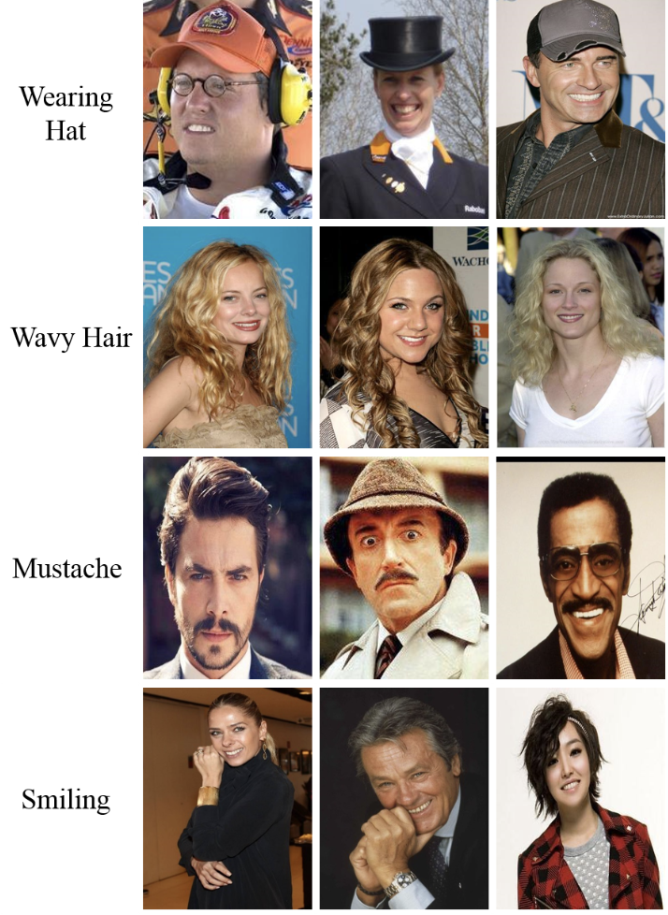
Dataset
CelebFaces Attributes Dataset (CelebA) is a large-scale face attributes dataset
More than 200K celebrity images, each with 40 attribute annotations
10,177 identities,
202,599 face images, and
5 landmark locations, 40 binary attributes annotations per image
DATA255 Project Presentation
Animated Face Image Generation using GANs

Slide 5
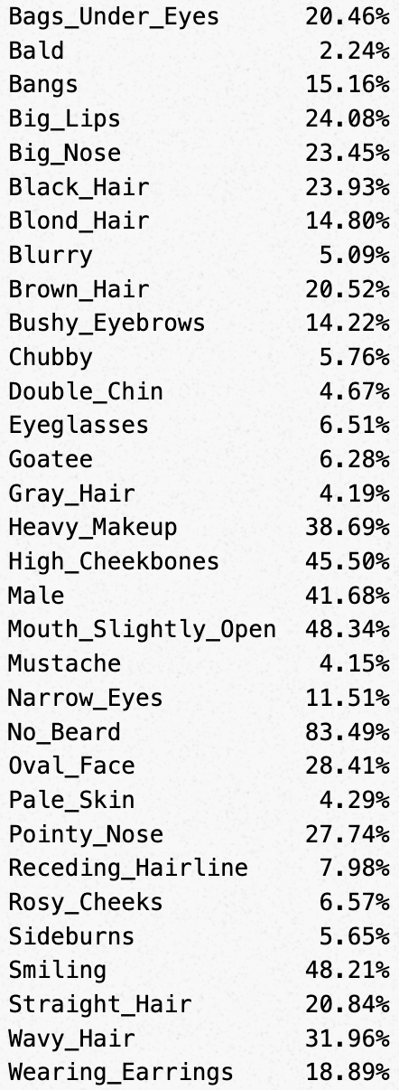
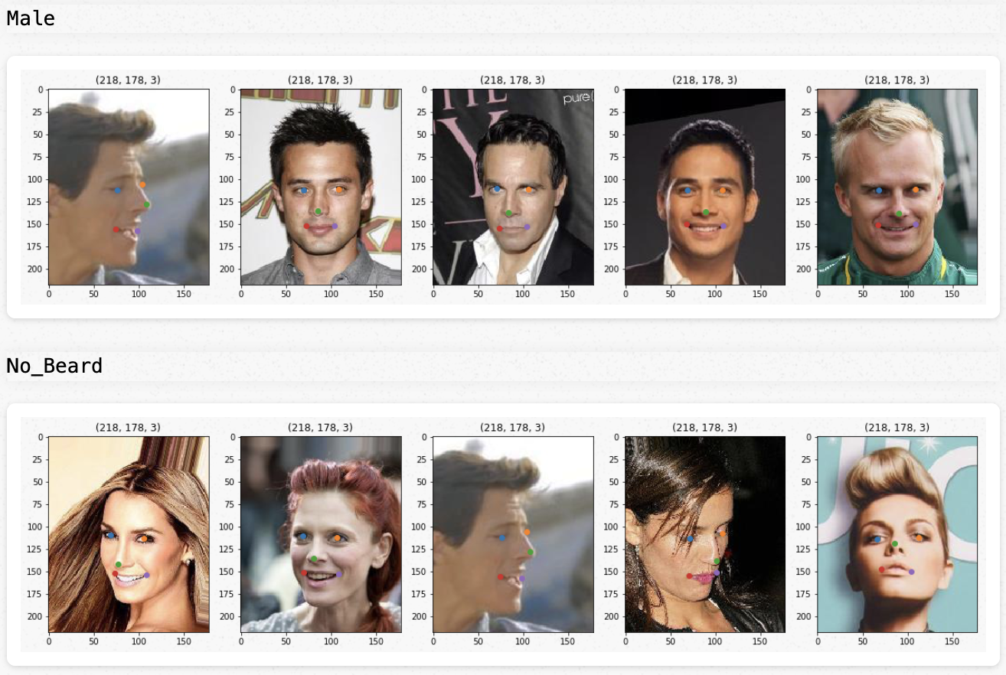
Celeb a Dataset EDA
DATA255 Project Presentation
Animated Face Image Generation using GANs

Slide 6
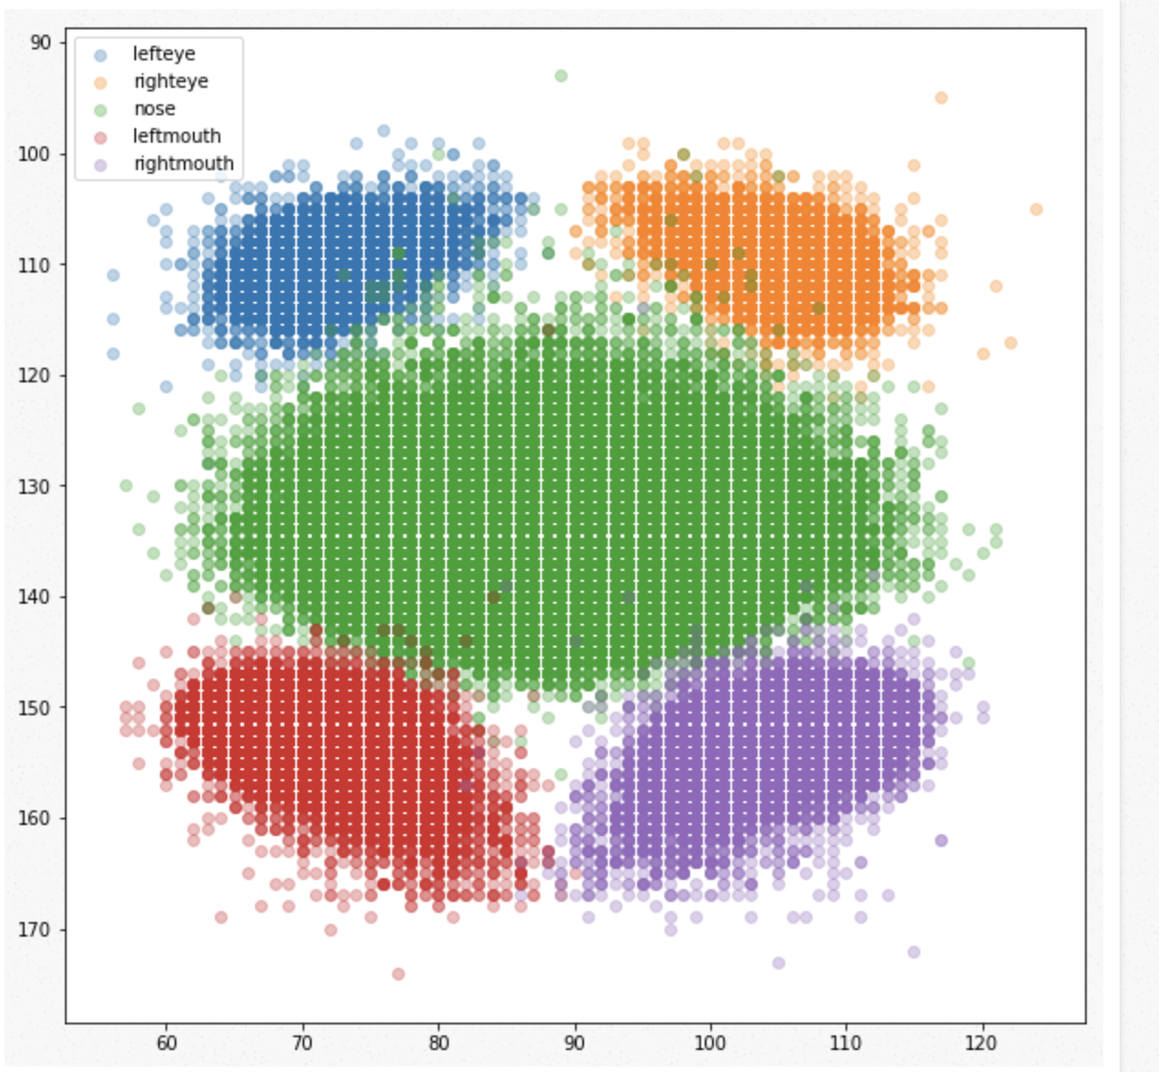
EDA
DATA255 Project Presentation
Animated Face Image Generation using GANs

Slide 7
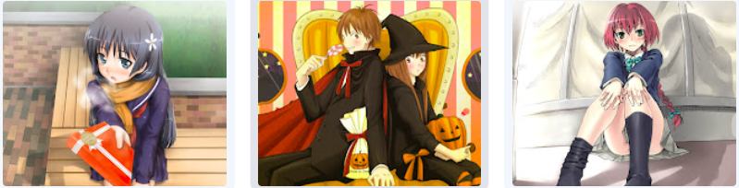
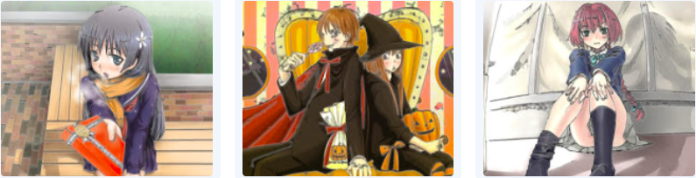
Cartoon Dataset
Data Preprocessing
Image Resizing
Safebooru cartoon dataset used for training
Safebooru is a tag-based image
Maintained by anime enthusiasts
Includes different unique attributes data
Golden eyes
Brown eyes
Blonde hair
Smile
Red hair
Image Smoothing
DATA255 Project Presentation
Animated Face Image Generation using GANs

Slide 8
Literature Review
Model | Year | Type | Dataset | Training Approach | Output Style | Complexity | Advantages
AnimeGAN | 2020 | GAN | Content Images-Real World Photos, Style Images- Anime Images | Unsupervised | Anime | Relatively Low Complexity | Low Computational Cost, High Quality Results, Flexibility
JOJOGAN | 2022 | GAN | Gan Inversion Produced | Unsupervised | Cartoon | High Complexity | No external dataset required, Produce output using Reference style
Cartoon StyleGAN-2 | 2021 | Style- based GAN | Webtoon, Disney, Metfaces images | Unsupervised | Cartoon | High Complexity | Can generate high-quality, diverse cartoonish images. Allows control over various image attributes through latent space manipulation.
CartoonGAN | 2018 | cGAN | Real World Photos from Coco Dataset, Cartoon Images, Smoothed version of Cartoon Images | Unsupervised | Cartoon | Moderate Complexity | Preserves content while transforming images into cartoon style, Good balance between computational cost and quality results, Flexibility in generating diverse cartoon-like images.
DATA255 Project Presentation
Animated Face Image Generation using GANs

Slide 9
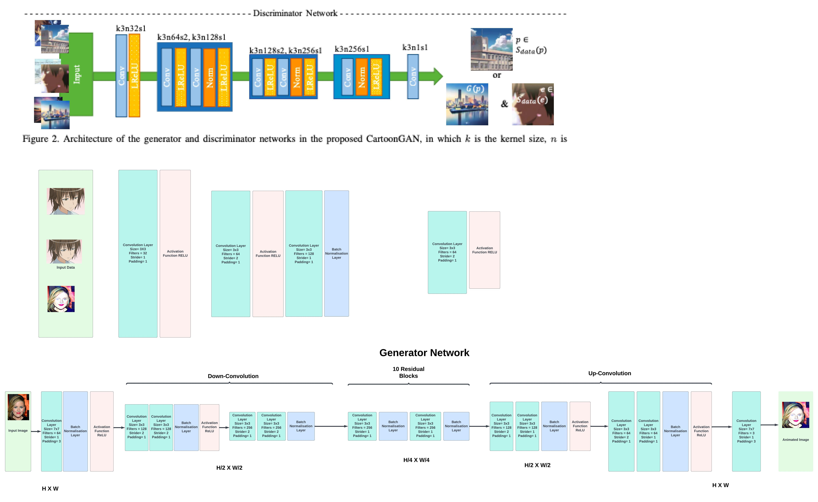
ArtifyGAN Model Architecture
Generator Network
DATA255 Project Presentation
Animated Face Image Generation using GANs
Notes:
Hello Everyone, So this is the model we have built from scratch and the name of our model is ArtifyGAN.
So for generating cartoon images from real images. Two things are needed clear edges and smooth shading.
In simple terms, generator architecture consists of three mains parts : encoder which extracts the features from the input images.
Transformer: which learns to transform the features to make it more similar to cartoon style. This information is received from adversarial loss.
Decoder: which takes the transformed image as an input and generates the output which is the cartoonized version of input images.
In this generator architecture, input image of shape 256 by 256 with 3 channels is pass through flat convolution stage of kernel size 7 which extract the low-level features and encode the image.
After this in the next phase , two down-convolution blocks are employed to further compress i.e. Reducing the H and W by a factor of 2 by using kernel size 3 and which further encodes the images. Down sampling technique is used to reduce the spatial dimensions of the feature maps and capture useful local signals in the images.
In the next phase, the encoded image is pass through 10 residual blocks and further reducing its dimension . They capture both the content features, which represent the underlying information and structure of the input images, and the manifold features, which represent the specific style and characteristics of cartoon images. By repeatedly applying the residual block layout, the model gradually learns to transform the input images into cartoon-style images by adjusting the features at each block. So here two loss functions play a key role:
The adversarial loss. Its value indicates to what extent the output image of the generator G looks like a cartoon image.
Content loss, which is define using vgg pretrained model. So vgg is used to extract feature maps from generated as well as real image and content loss is defined as the l1 norm of the difference between two.
During training, the generator network learns to map the input images to their corresponding cartoon-style images by minimizing a loss function.
In the last phase which is the up-sampling phase, two up-convolution blocks of kernel size 3 by 3 are used to restore the original dimension. Last convolution layer is used to produced images with 3 output chanels

Slide 10
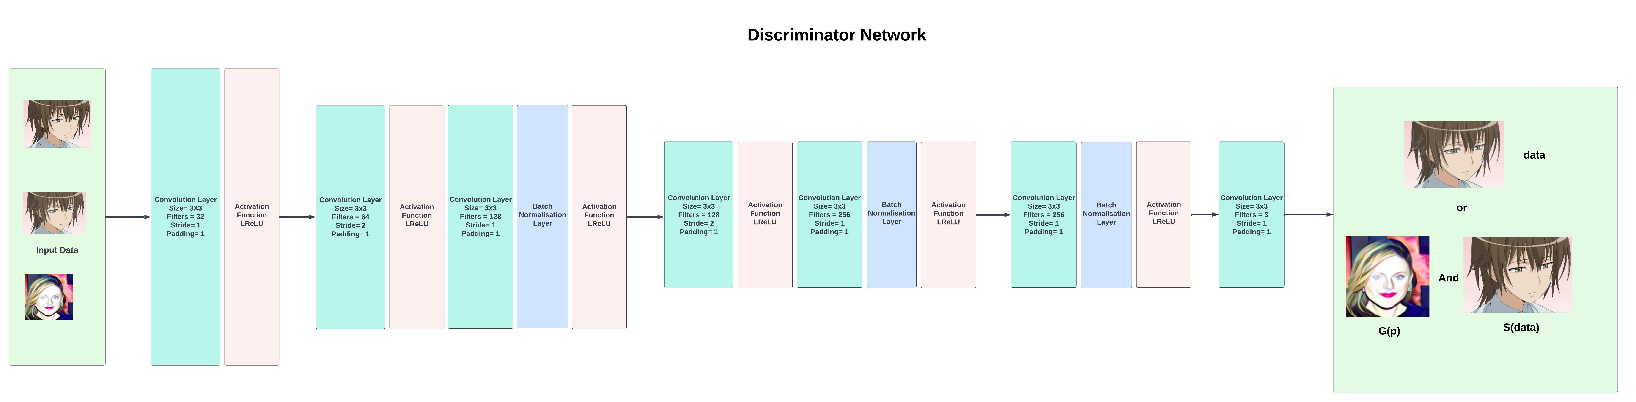
ArtifyGAN Model Architecture
Discriminator Network
DATA255 Project Presentation
Animated Face Image Generation using GANs
Notes:
This is the discriminator network is shallow as compared to generator.
The task of the discriminator D is to figure out whether the input image is synthesized from the generator or from the real cartoon dataset.
So, presentation of clear edges is very important in cartoon and simply training the discriminator with generated images and real cartoon images is not sufficient because it will clearly detect the edges in cartoon images. So further fool the discriminator, edge smoothing was done using edge canny detection from python skimage library and adding some gaussian noise to smooth the edges.
The aim of training the discriminator is to maximize the probability of clearly mapping each image i.e. whether it is fake or real.
Initially the images which are a mix of cartoon dataset, smoother version of it and synthesized images are passed through flat layers using leaky ReLU as activation function. After this , down sampling was done using two convolution blocks with stride 2 to reduce the dimension and capture the local information for classification. In this stage important information is capture while discarding the unnecessary details. Leaky ReLU with alpha = 0.2 is used after each normalisation layer.
After this a feature construction block is applied to further process the feature maps. This block consist of one convolutional layers with kernel size 3x3
Finally, convolutional layer is employed to obtain the classification response. And this feedback is provided to generator to further create more visually appealing cartoon images.
So the discriminator network in CartoonGAN plays a crucial role in the adversarial training process.
So based on GAN architecture, generator optimizes it weights to produce desired output based on adversarial loss

Slide 11
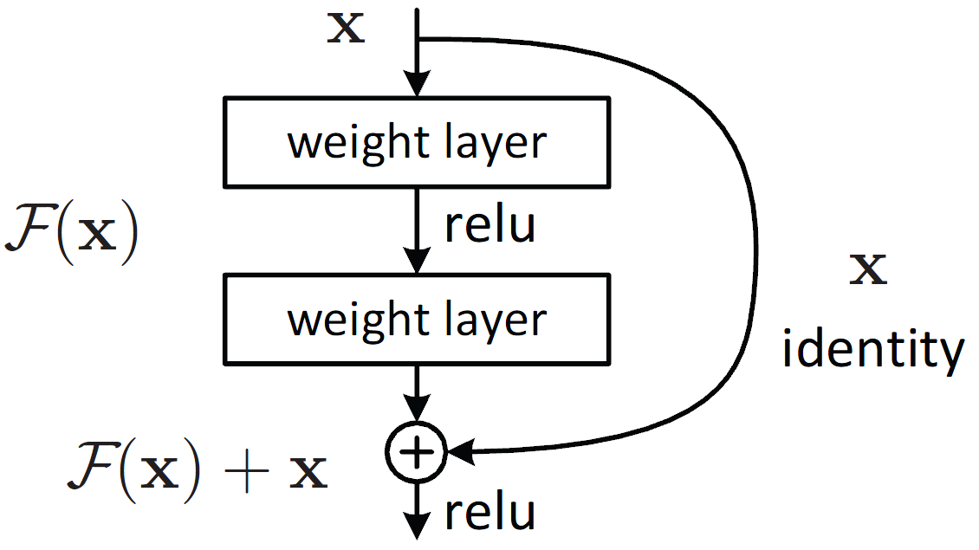
ArtifyGAN
Inspired from CartoonGAN architecture
Increased the ResNet blocks from 8 to 10 to
Improve feature extraction
Better representation learning
Increase Model capacity
Removed the Convolution filters after the ResNet blocks to improve the computational efficiency
Coco Dataset and celeb a was used instead of Flickr data
Safebooru Cartoon dataset was used instead of extracting images from anime movie “Spirited Away”
DATA255 Project Presentation
Animated Face Image Generation using GANs
Notes:
So our model was inspired from cartoongan.
A few modification was done with which we were able to achieve good quality results in limited resourced and less number of epochs.
This was done by increasing more residual block to capture the content information as well as to increase model capacity.
So in the cartoon gan, 4 more convolution layer were used after resnet blocks, we have removed this layer to improve the computational efficiency.
We have trained our model using coco and celeb a dataset instead of flickr data
Also, we have used cartoon images from safebooru where as cartoon gan has used screenshots from animated movie.

Slide 12
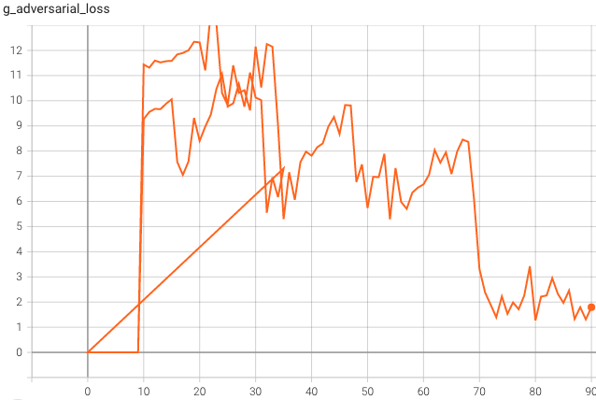
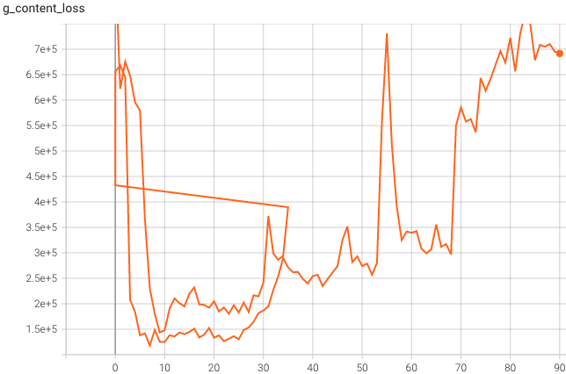
Experimental Settings
Category | Requirement
Hardware | GPU (Google Colab)
Software | Google Colab (Jupyter notebook)
Libraries | PyTorch, NumPy, Matplotlib, PIL, OpenCV, tqdm, TensorBoard
Hyper-parameters
Optimizer | Adam Learning rate: 0.001
w | 0.00001
Epochs | 240
Batch Size | 16
Loss Function | Adversarial Loss
DATA255 Project Presentation
Animated Face Image Generation using GANs
Notes:
So this is the experinment settings,
We have built our model using pytorch and opencv library to preprocess the image and save the results on tensor board.
With respect to hyper-parameter, model was trained for 240 epochs with batch size 16 . Adamp optimizer was used with learning rate 0.001 and beta 1 and beta 2 = as 0.5 and 0.99 for exponential smoothing parameter.
Here one important hype-parameter is W is tradeoff between adversarial loss and content loss. We have taken w here at 0.0001 to map real images similar to cartoon style. The higher the w is, the more content is preserved.
So here we can see the adversarial and content loss graph. So after the 78 epochs, adversarial loss was decreasing i.e model wsa able to create cartoon styles images but content loss was not preserved for the images. So to balance both we have selected the model at best checkpoint which was at 74 epoch

Slide 13
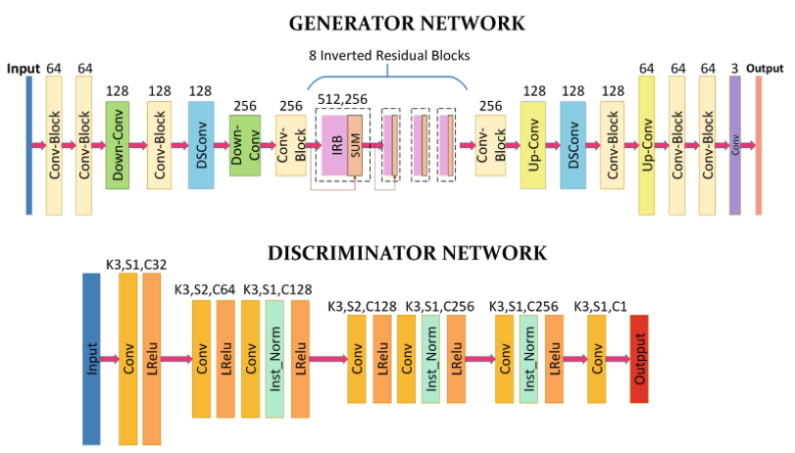
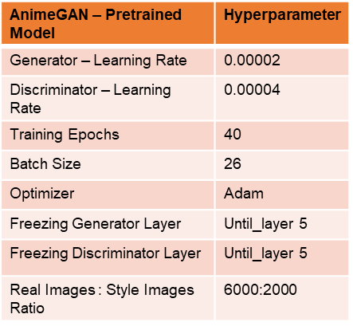
AnimeGAN Pre-trained Model Experimental Setting
Fine Tuning:
Fine-tuned and trained on preprocessed animated images(maintained the ratio of Anime and celebA)
Reduced the training time by decreasing the size of dataset from 1hr to 5 min/epoch
DATA255 Project Presentation
Animated Face Image Generation using GANs

Slide 14
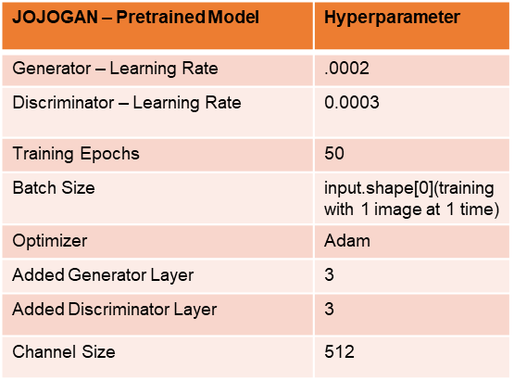
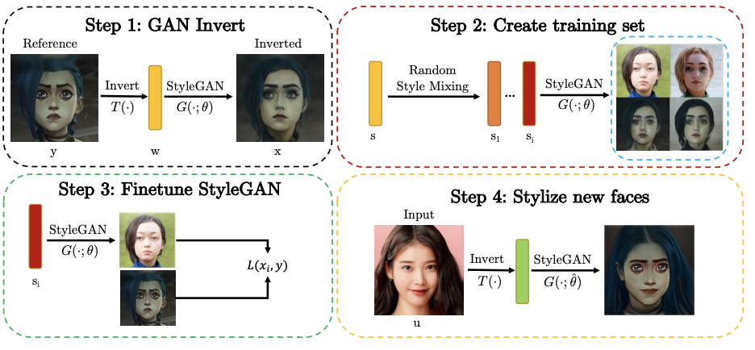
JOJOGAN Pre-trained Model Experimental Setting
Fine Tuning:
Fine-tuned and trained on preprocessed 1 cartoon style image
Reduced the training time(ms) and the memory consumption of using
the decreased discriminator channel size.
DATA255 Project Presentation
Animated Face Image Generation using GANs

Slide 15
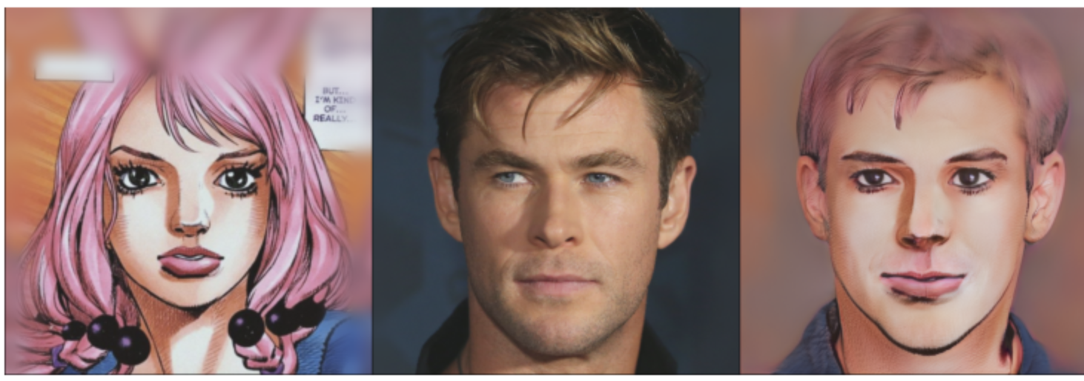
JOJOGAN output
DATA255 Project Presentation
DATA255 Project Presentation

Slide 16
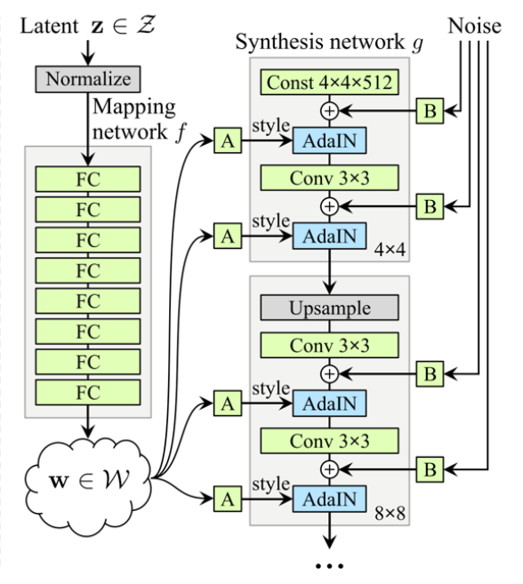
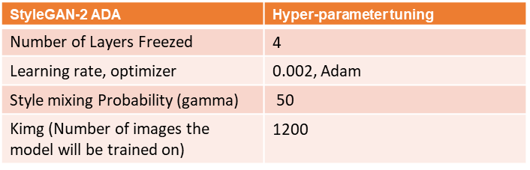
StyleGAN-2 Pre-trained Model Experimental Setting
Fine Tuning:
Fine-tuned and trained on preprocessed data (Image Upsizing, Face Alignment, Converting 32-bit images to 24-bit images)
DATA255 Project Presentation
Animated Face Image Generation using GANs
Notes:
Freezed 4 layers and trained the remaining layers on TrueBeauty data. Done to prevent lower layers from overfitting to the TrueBeauty data and to retain the features learned from the FFHQ dataset.

Slide 17
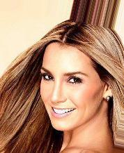
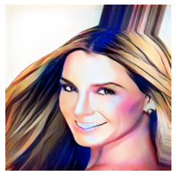
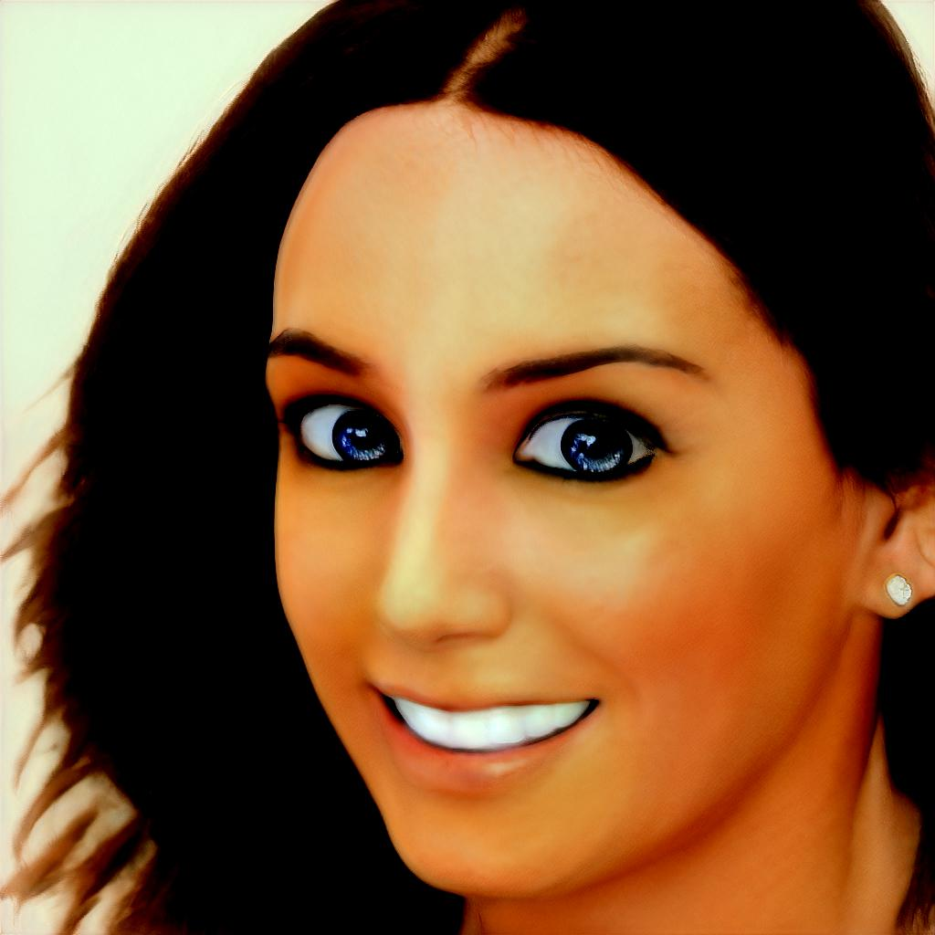
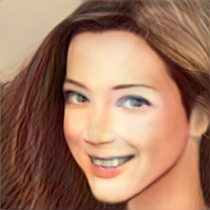
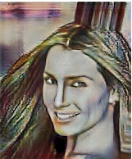
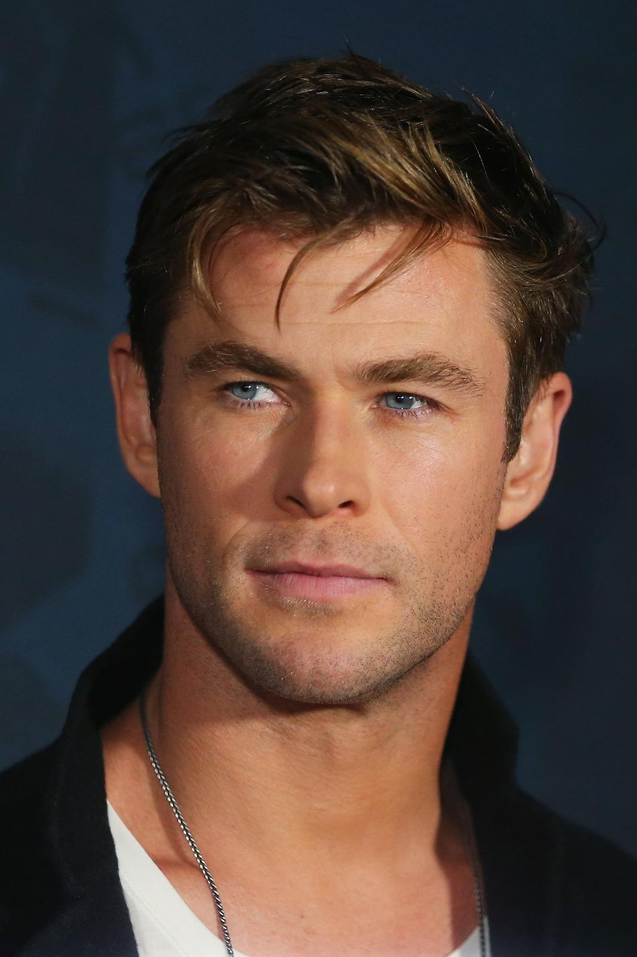
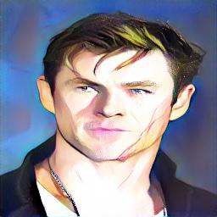
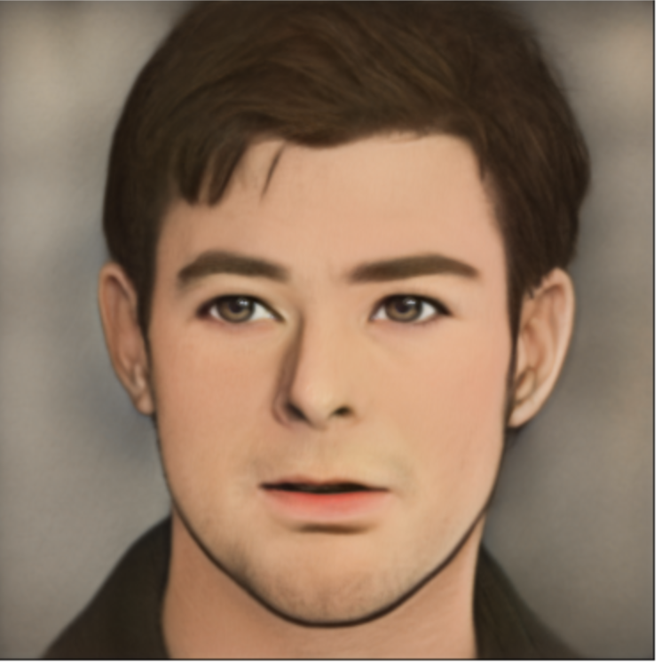
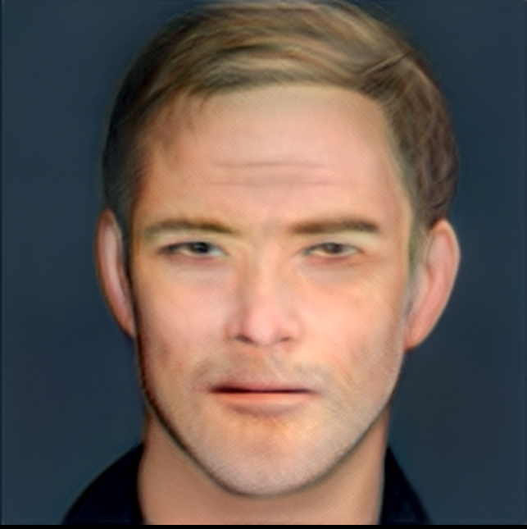
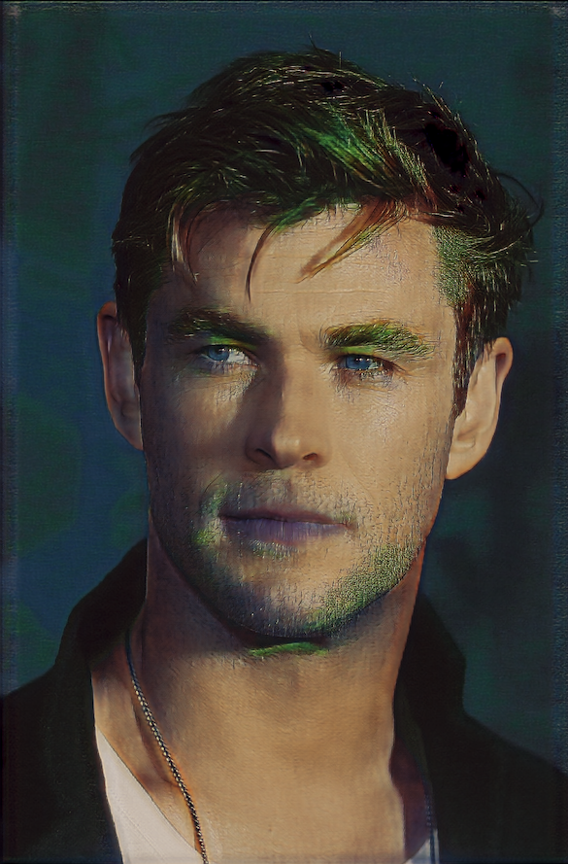
Result Analysis
Original Image
ArtifyGAN
Jojo GAN
StyleGAN 2
AnimeGAN
DATA255 Project Presentation
Animated Face Image Generation using GANs

Slide 18
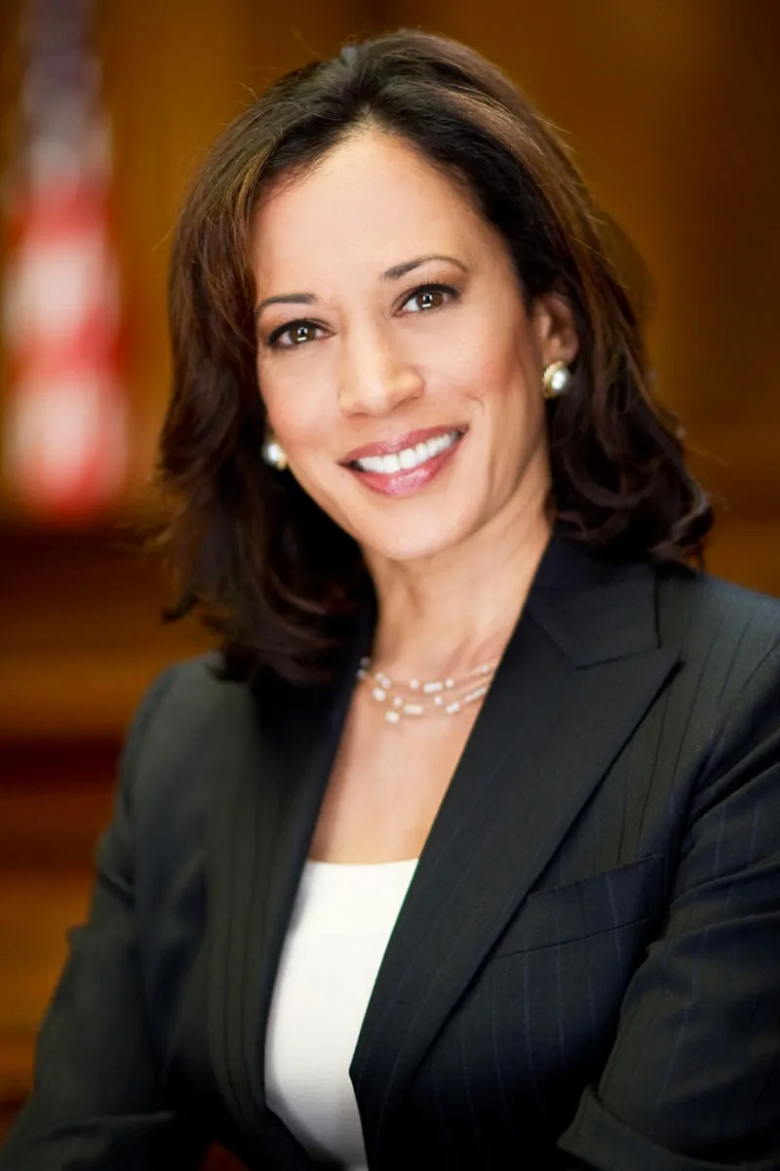
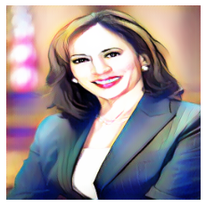
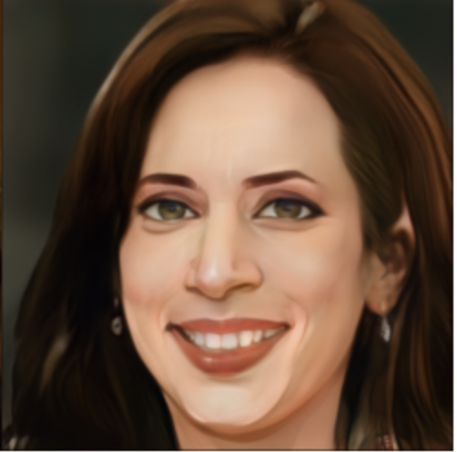
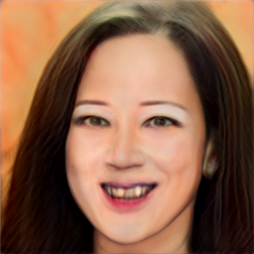
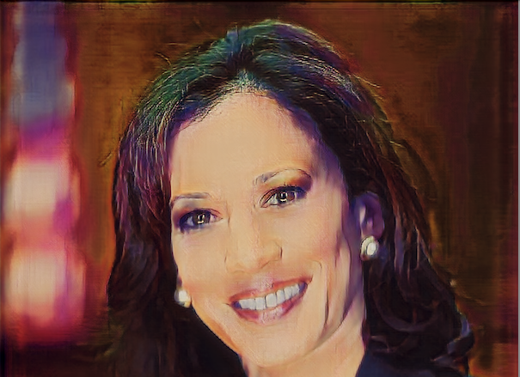
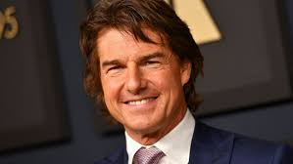
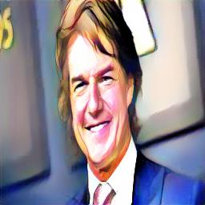
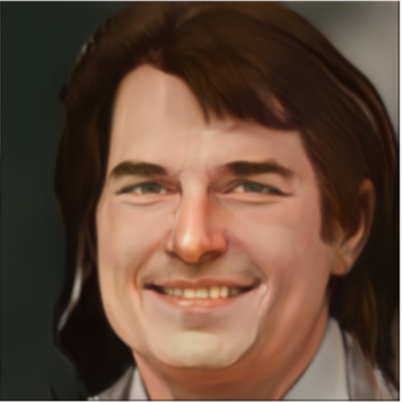
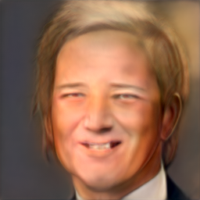
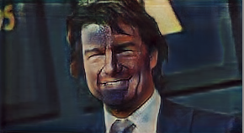
Result Analysis
Original Image
ArtifyGAN
Jojo GAN
StyleGAN 2
AnimeGAN
DATA255 Project Presentation
Animated Face Image Generation using GANs

Slide 19
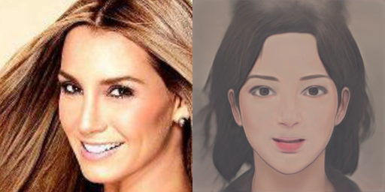
Image Translation Phases
DATA255 Project Presentation
Animated Face Image Generation using GANs

Slide 20
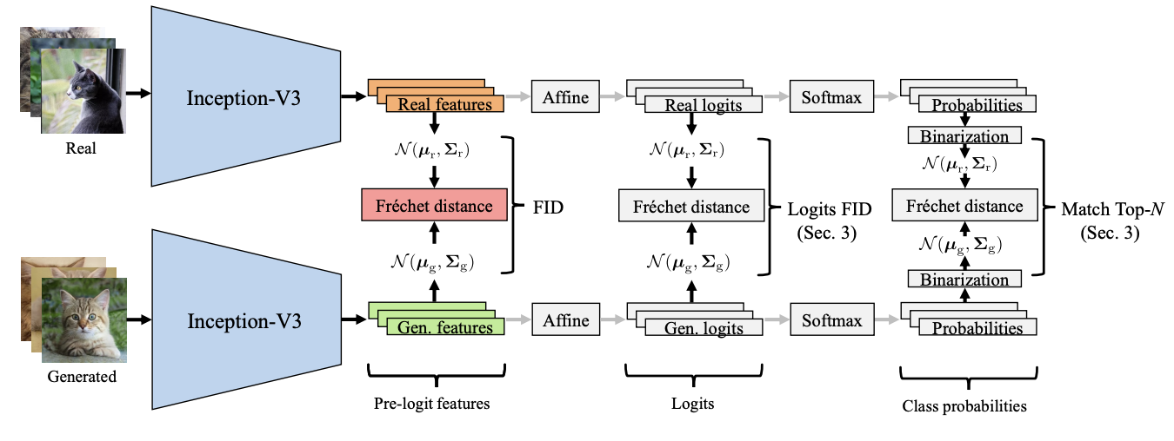
Evaluation Metrics FID (Frechet Inception distance)
The key idea behind in FID is to separately embed real and generated images to a vision-relevant feature space, and compute a distance between the two distributions
Step 1. Images passed through a pre-trained classifier network (eg. Inception-V3) to produce feature vectors
Step 2. Both distributions of features are approximated to calculate the distance
Lower is better !!
DATA255 Project Presentation
Animated Face Image Generation using GANs

Slide 21
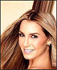
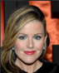
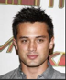
Evaluation Metrics
FID-Metric
Model | Image1 | Image2 | Image3 | Image4 | Image5 | Image6 | Mean | Total
AnimeGAN | 201.03 | 212.64 | 187.43 | 147.10 | 210.36 | 155.08 | 185.60 | 1113.64
StyleGAN2 | 93.14 | 100.46 | 137.99 | 77.84 | 140.91 | 137.6262 | 114.65 | 687.99
ArtifyGAN | 107.10 | 89.81 | 96.70 | 103.16 | 179.13 | 135.91 | 118.63 | 711.82
JOJOGAN | 183 | 177 | 170 | 180 | 190 | 173 | 178.8 | 1073
DATA255 Project Presentation
Animated Face Image Generation using GANs
Notes:
Hence it is important to not only consider not only to consider mean FID score but visually examine the animated images generated for evaluating the quality of the generated image

Slide 22
Conclusion
ArtifyGAN is less complex as compared to other existing models for generating animated images
Designing the model from scratch allowed us to define the architecture and modify hyperparameters to better suit our specific dataset and target style
Although ArtifyGAN was trained on a smaller dataset and for less training time as compared to other pre-trained models, it is still producing high-quality animated results
DATA255 Project Presentation
Animated Face Image Generation using GANs

Slide 23
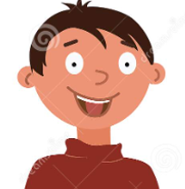
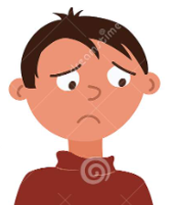
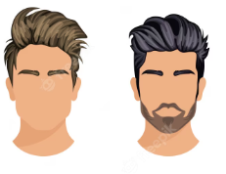
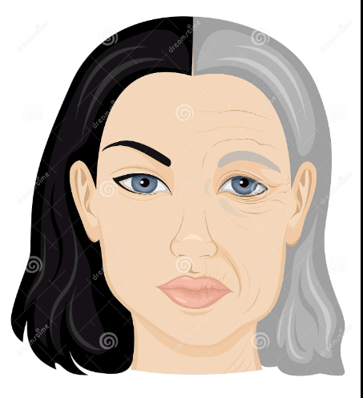
Future Works
Expression transfer: To transfer expressions between different faces in the dataset
Facial feature modification: To modify other facial features like hairstyle, adding accessories like glasses or hat
Training on a larger and diverse dataset: To improve its generalization capabilities
Age progression: To create animated images of faces that look older or younger than the original input.
DATA255 Project Presentation
Animated Face Image Generation using GANs

Slide 24
References
Back, J. (2021). Fine-Tuning StyleGAN2 For Cartoon Face Generation. arXiv (Cornell University). https://doi.org/10.48550/arxiv.2106.12445
Chen, J., Liu, G., & Chen, X. (2019). AnimeGAN: A Novel Lightweight GAN for Photo Animation. In Communications in computer and information science (pp. 242–256). Springer Science+Business Media. https://doi.org/10.1007/978-981-15-5577-0_18
Chong, M. J., & Forsyth, D. (2022, October). Jojogan: One shot face stylization. In Computer Vision–ECCV 2022: 17th European Conference, Tel Aviv, Israel, October 23–27, 2022, Proceedings, Part XVI (pp. 128-152). Cham: Springer Nature Switzerland.
Chen, Y., Lai, Y., & Liu, Y. (2018). CartoonGAN: Generative Adversarial Networks for Photo Cartoonization.
https://doi.org/10.1109/cvpr.2018.00986
DATA255 Project Presentation
Animated Face Image Generation using GANs

Slide 25

Thank you
Comparative Performance Analysis - Cassandra Vs MongoDB

